Slide 1
MS/HS Reading Interventions
Guided Reading and Fluency Interventions for Tier 2-3
Follow along with the pg. numbers here.
Pg. #
Notes:
Welcome
Let’s dive into reading intervention
You can follow along at the bottom
This is for MS/HS Folks so if you are elementary you are in the wrong spot
- First let me introduce myself

Slide 2
The Story. . .
Me
Us
Now

Slide 3
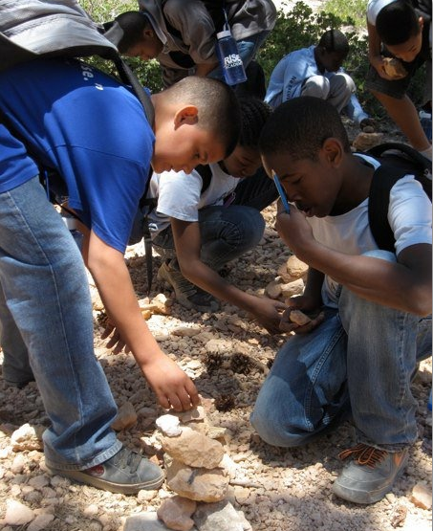
The Story. . .
Me
Us
Now

Slide 4
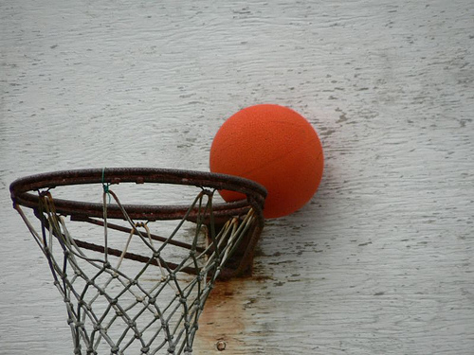
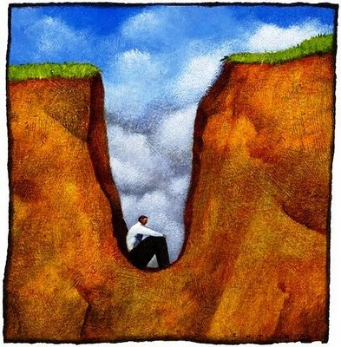
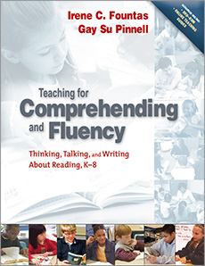
The Story. . .
Lessons Learned

Slide 5
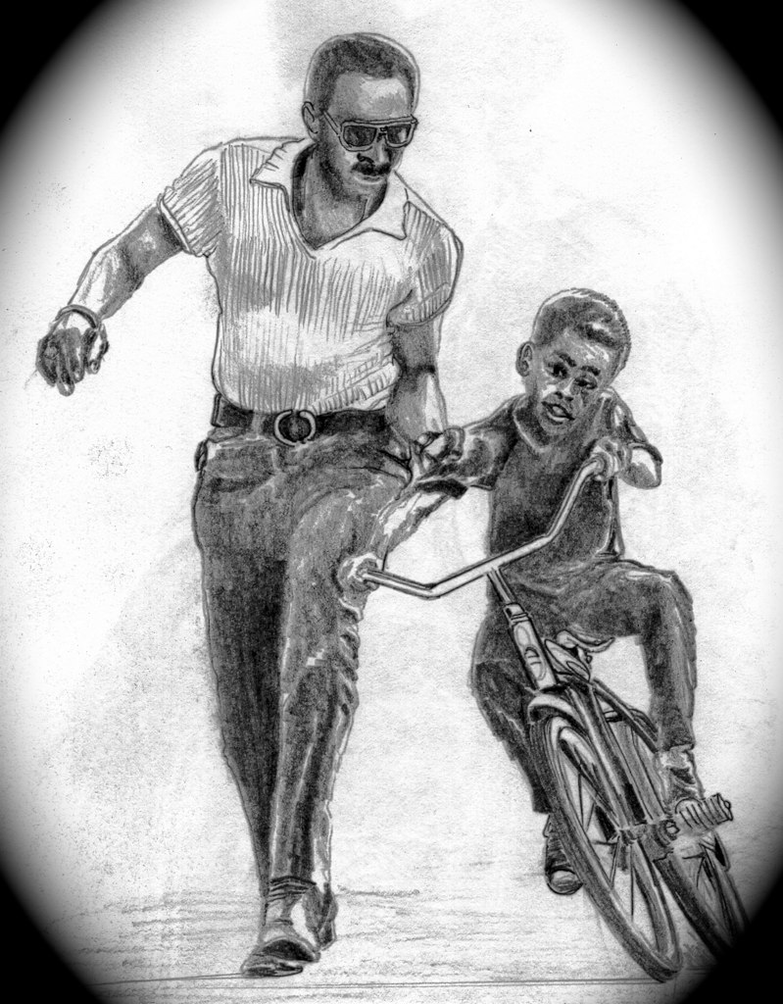
The Story. . .
Consistency
Data Driven
Matching Supports

Slide 6
The Story. . .
Me
Us
Now

Slide 7
The Story . . .
Consistent Practice
Varying Data Practices during GR
Mismatched Support
Notes:
Why are we focusing on this right now?
We are at a place where schools consistently have reading intervention time for GR & Fluency. The structures are in place. Also, the vast majority of schools use data to determine which students are in which groups and observing and providing feedback on interventions.
However, when we observe scholars reading aloud or providing partial understanding of the text, we are not consistently able to get them the right level of support that over time leads to stronger independent readers.
What we’ve observed is that too often the level of support is mismatched or teachers lack the knowledge and skills to provide support in the moment when they see a scholar struggling to understand or read fluently. We aren’t breaking it down or using BPQs effectively to get a scholar there and the scholar move from teacher-monitoring, to self-monitoring, to self-correcting to independent.

Slide 8
The Story. . .
Me
Us
Now

Slide 9
The Story. . .
Align on a clear vision for strong GR
Practice Conferring
Notes:
How will we close this EXECUTION GAP?
Therefore, this year we will focus on MODELLING and PRACTICE/DRILLS to directly address the execution gap.
SSLs and Teachers will be able to …
Execute an effective and efficient fluency practice.
Execute an effective fluency and comprehension conference with the most common mistakes and misunderstandings that we see.

Slide 10
Aims
School Leaders Will Be Able To:
Explain the structure and non-negotiables of GR.
Execute an effective fluency practice during GR.
Execute an effective fluency (Accuracy focused) conference during GR.
Plan and execute an effective comprehension conference during GR.

Slide 11
Agenda
Vision for Guided Reading
Fluency Conferring
Close Out
15 mins
20 mins
30 mins
45 mins
45 mins
15 mins
Introduction
Comprehension Conferring
Fluency Practice
Notes:
-We will first look at the vision for strong guided reading
Then practice this PD.
You should plan to turnkey this session with GR teachers at school sites or send you and your gr teachers to training in the fall.

Slide 12
Two Hats

Slide 13
We WILL We WON’T
Practice the session in full “as if” we are teachers
Get access to all theses materials and ATT Materials
Focus on fluency practice, and conferring
Go through how to plan
Go through how to create groups
Go through how to F&P Test
Go deep on the introduction or discussion

Slide 14
Data Dive
Directions: Based on the EOY Universal Screener Data, what can you infer is the major factor holding the majority of scholars back from being above both triggers?
How does this data compare with your school’s current thinking of scholar’s needs? Similar? Different? Why?
 |  | Above Both | Below Accumaticity | Below Lexile | Below Both
School Name | # Tested | No Intervention | Fluency Needed | Guided Reading | Guided Reading & Fluency
AF Bridgeport MS | 360 | 24% | 4% | 43% | 29%
AF Hartford MS | 151 | 25% | 5% | 38% | 32%
AF Summit MS | 143 | 15% | 5% | 49% | 31%
Amistad Academy MS | 352 | 34% | 7% | 38% | 21%
Elm City College Prep MS | 109 | 31% | 7% | 32% | 29%
AF Apollo MS | 188 | 46% | 4% | 36% | 15%
AF Brownsville MS | 340 | 44% | 5% | 36% | 14%
AF Bushwick MS | 368 | 49% | 8% | 31% | 12%
AF Crown Heights MS | 282 | 50% | 7% | 26% | 16%
AF East New York MS | 250 | 50% | 9% | 30% | 12%
AF Endeavor MS | 354 | 35% | 5% | 37% | 23%
Average/Total | 2897 | 37% | 6% | 36% | 21%
2
Notes:
Let’s look at a set of data to get our heads around the need.
Looking at the data, what is holding the majority of scholars from being above both triggers?
How does this compare with you’re schools current thinking of scholar’s needs?
Turn and talk. Share out a few pieces you heard and cold call.

Slide 15
Guided Reading is the most
“authentic” reading intervention, that slowly releases independence, and offers targeted support,
by putting the heavy lifting on the scholar.
Notes:
We believe that - READ slow and with emphasis.
The two most important parts here are authentic and releasing independence.
Our job will be to do these two things well.

Slide 16
Guided Reading Non-Negotiables
Directions: Your Job: Watch the video and record your responses on pg. 3.
What are the key components that make this a strong intervention?
Video | Key Components
Fluency Practice
GR Fluency Conference
GR Comprehension Conference
SORRY!
Add in a section here or at bottom for introduction
3
Notes:
SAY: Before we can go any further we need to first get the first vision of what strong GR looks like for next year. You will observe a fluency practice then GR Introduction, Conferring (Accuracy & Comp.) As you observe on pg. x note what key components that make this a strong intervention. I will be intentionally skipping the discussion at the end because it’s very similar to the discussion that would occur to during lit. block/class.
SAY: (Choose 1 participant) To ensure I’m clear on what you’re doing as we watch, can you tell us what is your thinking job?
<10 min.> Video of Danielle and Anna Reeves GR Block: (10 minute max)
Fluency Practice – What are the key parts of strong fluency practice?
GR Introduction – What are the key components of the GR Introduction?
GR Conferring – What are the key parts of a GR Conference?
GR Discussion – What are the Key parts of GR Conference?

Slide 17
What are the key components that make fluency practice strong?
https://video.achievementfirst.org/media/Video+1+-+Daily+Fluency+Practice+-+Danielle+Camero+-+ENYMS+April+2016+-+6+min./1_4j3t5d3w/44106882

Slide 18
What are the key components of the fluency practice?

Slide 19
KEY POINT #1
Strong fluency practice has consistent routines and procedures around repeated fluent reading on grade level texts.

Slide 20
Portion | Key Components | Evidence | BPQs
Fluency Practice Fluent reading and automaticity | Partner and whole group Data-driven Grade level Texts Reinforced Fluent reading | Scholars had 3 opportunities to read the text over. They received feedback from a partner. | How many times did scholars get practice reading fluently? What is the impact on fluent reading?
GR – Introduction Providing access to the text | Names key vocabulary words Activates prior knowledge Engages scholars in the text | Introduces reduce and recycle Discusses the water bottle as a spring board for vocabulary Gives the thinking question for scholars | How does she ensure scholars can read all the words? How does Anna ensure that scholars have the appropriate background knowledge and can connect?
GR- Conferring – Fluency Support the scholar’s fluent reading | Scholar Reads Teacher IDs errors & Responds Teacher records data | Running Record Punches errors Narrates what the scholar needs to do better | What is the process that she uses to id mistakes?
GR Conferring – Comprehension Support a scholar to literally and deeply comprehend a text | Scholar shares their thinking Teacher pinpoints misunderstand & responds Transfer of the skill | X tells what he read about. Anna responds to the misunderstanding by prompting. She transfers the skill and records it in the tracker? | How does Anna use the tracker? What purpose does it serve? How does Anna choose what she’s conferring on ?
Notes:
SAY: What are the key components of the Fluency and Guided Reading intervention? (Cold Call) Name 1 element of Fluency. Why is that important?
Name the key points clearly 1 more time and have folks reference their notes to the FOIs
SAY: I want to name a few differences and similarities with GR and Lit and then Elementary school GR for folks that have that context:
Difference and Similarities to BPQs in Lit class. – They are very very similar, in terms of breaking down the understanding – the difference is that you want to keep your prompting to a 2-3 prompts and the move to demonstrate for the scholar, because these should be strategies they know and your supporting them in using them in the text. In GR, our prompts and support are around strategy but in Lit it’s around the text itself.
Difference and Similarities to Elementary – In Elementary GR is less of an intervention but a key component of reading. I say that to explain structurally GR is a bit different. There is more emphasis on the discussion at the end and more explicitly strategy teaching because kids are closer together in their needs.

Slide 21
What are the key components that make the introduction strong?
https://video.achievementfirst.org/media/Video+2+-+Guided+Reading+Introduction+-+Anna+Reeves+-+ENDMS+March+2016+-+6+min./1_hs416gci/44106882

Slide 22
What are the key components of the introduction?

Slide 23
KEY POINT #2
Guided Reading introduction gives a scholar enough access to the text to independently comprehend it.

Slide 24
Portion | Key Components | Evidence | BPQs
Fluency Practice Fluent reading and automaticity | Partner and whole group Data-driven Grade level Texts Reinforced Fluent reading | Scholars had 3 opportunities to read the text over. They received feedback from a partner. | How many times did scholars get practice reading fluently? What is the impact on fluent reading?
GR – Introduction Providing access to the text | Names key vocabulary words Activates prior knowledge Engages scholars in the text | Introduces reduce and recycle Discusses the water bottle as a spring board for vocabulary Gives the thinking question for scholars | How does she ensure scholars can read all the words? How does Anna ensure that scholars have the appropriate background knowledge and can connect?
GR- Conferring – Fluency Support the scholar’s fluent reading | Scholar Reads Teacher IDs errors & Responds Teacher records data | Running Record Punches errors Narrates what the scholar needs to do better | What is the process that she uses to id mistakes?
GR Conferring – Comprehension Support a scholar to literally and deeply comprehend a text | Scholar shares their thinking Teacher pinpoints misunderstand & responds Transfer of the skill | X tells what he read about. Anna responds to the misunderstanding by prompting. She transfers the skill and records it in the tracker? | How does Anna use the tracker? What purpose does it serve? How does Anna choose what she’s conferring on ?
Notes:
SAY: What are the key components of the Fluency and Guided Reading intervention? (Cold Call) Name 1 element of Fluency. Why is that important?
Name the key points clearly 1 more time and have folks reference their notes to the FOIs
SAY: I want to name a few differences and similarities with GR and Lit and then Elementary school GR for folks that have that context:
Difference and Similarities to BPQs in Lit class. – They are very very similar, in terms of breaking down the understanding – the difference is that you want to keep your prompting to a 2-3 prompts and the move to demonstrate for the scholar, because these should be strategies they know and your supporting them in using them in the text. In GR, our prompts and support are around strategy but in Lit it’s around the text itself.
Difference and Similarities to Elementary – In Elementary GR is less of an intervention but a key component of reading. I say that to explain structurally GR is a bit different. There is more emphasis on the discussion at the end and more explicitly strategy teaching because kids are closer together in their needs.

Slide 26
What are the key components that make the conferring strong?
https://video.achievementfirst.org/media/Video+3b+-+Guided+Reading+Fluency+Conference1+-+Anna+Reeves+-+ENDMS+March+2016+-+3+min./1_nwhfn6go/44106882

Slide 27
What are the key components of the fluency and comprehension conference?

Slide 28
KEY POINT #3
Guided Reading conferring checks the scholar’s response against the exemplar and then matches the response.

Slide 29
Portion | Key Components | Evidence | BPQs
Fluency Practice Fluent reading and automaticity | Partner and whole group Data-driven Grade level Texts Reinforced Fluent reading | Scholars had 3 opportunities to read the text over. They received feedback from a partner. | How many times did scholars get practice reading fluently? What is the impact on fluent reading?
GR – Introduction Providing access to the text | Names key vocabulary words Activates prior knowledge Engages scholars in the text | Introduces reduce and recycle Discusses the water bottle as a spring board for vocabulary Gives the thinking question for scholars | How does she ensure scholars can read all the words? How does Anna ensure that scholars have the appropriate background knowledge and can connect?
GR- Conferring – Fluency Support the scholar’s fluent reading | Scholar Reads Teacher IDs errors & Responds Teacher records data | Running Record Punches errors Narrates what the scholar needs to do better | What is the process that she uses to id mistakes?
GR Conferring – Comprehension Support a scholar to literally and deeply comprehend a text | Scholar shares their thinking Teacher pinpoints misunderstand & responds Transfer of the skill | X tells what he read about. Anna responds to the misunderstanding by prompting. She transfers the skill and records it in the tracker? | How does Anna use the tracker? What purpose does it serve? How does Anna choose what she’s conferring on ?
Notes:
SAY: What are the key components of the Fluency and Guided Reading intervention? (Cold Call) Name 1 element of Fluency. Why is that important?
Name the key points clearly 1 more time and have folks reference their notes to the FOIs
SAY: I want to name a few differences and similarities with GR and Lit and then Elementary school GR for folks that have that context:
Difference and Similarities to BPQs in Lit class. – They are very very similar, in terms of breaking down the understanding – the difference is that you want to keep your prompting to a 2-3 prompts and the move to demonstrate for the scholar, because these should be strategies they know and your supporting them in using them in the text. In GR, our prompts and support are around strategy but in Lit it’s around the text itself.
Difference and Similarities to Elementary – In Elementary GR is less of an intervention but a key component of reading. I say that to explain structurally GR is a bit different. There is more emphasis on the discussion at the end and more explicitly strategy teaching because kids are closer together in their needs.

Slide 30
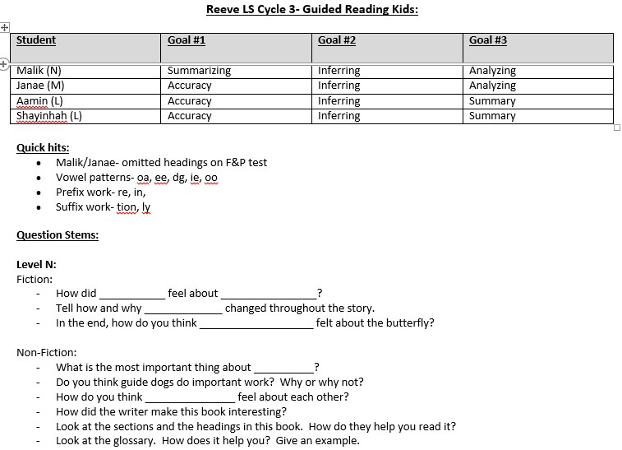
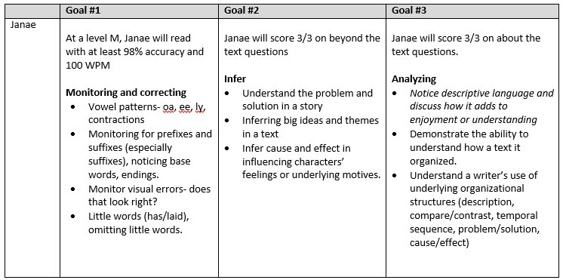
PROGRESS GOAL PLANNING BASED ON F&P DATA
GOAL BREAKDOWN USING CONTINUUM

Slide 31
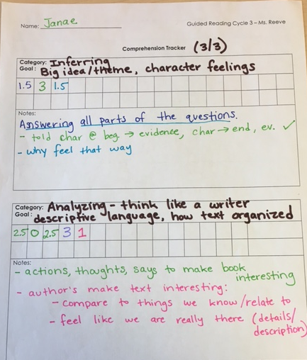
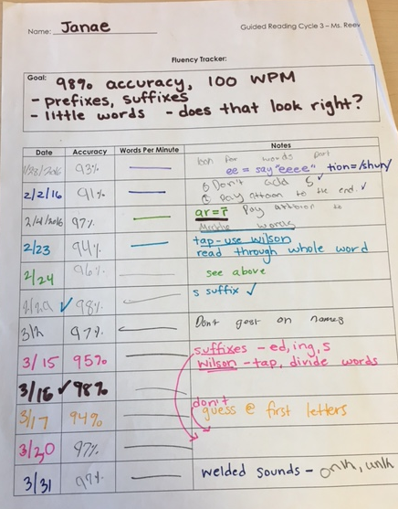
Comprehension Conference
Fluency Conference
FLUENCY CONFERRING TRACKER
COMPREHENSION CONFERRING TRACKER

Slide 32
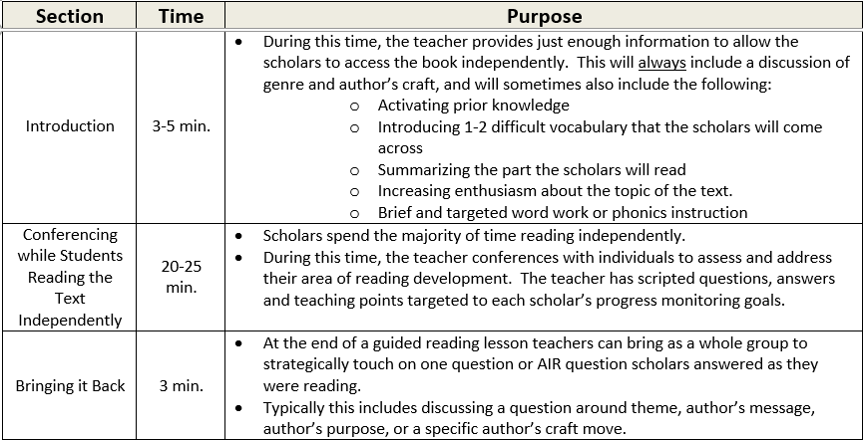
Guided Reading Structure
Fluency Practice
10 min.
FOCUS AREA

Slide 33
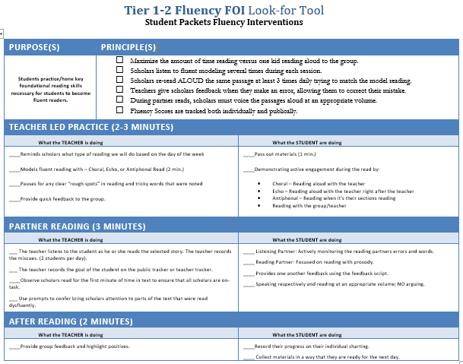
Key Principles of Fluency Intervention
Teacher Led Portion
Partner Reading
After Reading
5

Slide 34
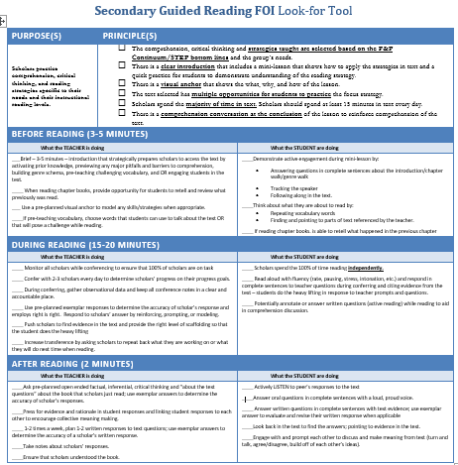
Key Principles of Guided Reading
Before Reading
During Reading
After Reading
6

Slide 35
Agenda
Vision for Guided Reading
Fluency Conferring
Close Out
15 mins
20 mins
30 mins
45 mins
45 mins
15 mins
Introduction
Comprehension Conferring
Fluency Practice
Notes:
-We will first look at the vision for strong guided reading
Then practice this PD.
You should plan to turnkey this session with GR teachers at school sites or send you and your gr teachers to training in the fall.

Slide 36
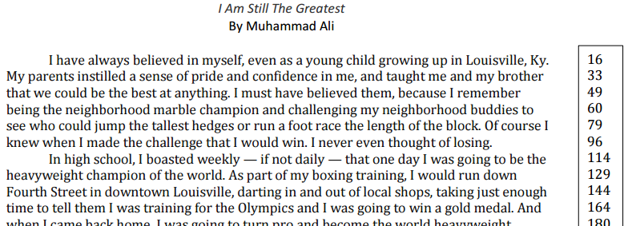
Fluency Practice
Objective: Participants will get multiple at bats to practice running the fluency practice during the start/end of GR conferencing using the Tier 1-2 Passages.
DRILL 1: Modelling Fluent Reading
Directions: Teachers read 1 min. aloud the passage modeling fluent reading and monitoring scholars reading. Then the teacher highlights any tricky words to emphasize. No feedback in this round.
7
Notes:
You will practice the various components of the fluency tier 1 program for each day (Choral reading, partner reading, feedback and record). In each round we will tackle a new segment.

Slide 37
Drill 1 – Model Fluent Reading
Objective: Participants will get multiple at bats to practice running the fluency practice during the start/end of GR conferencing using the Tier 1-2 Passages.
DRILL 1: Modelling Fluent Reading
Directions: Teachers read 1 min. aloud the passage modeling fluent reading and monitoring scholars reading. Then the teacher highlights any tricky words to emphasize. No feedback in this round.
Rotation (1 Min) | Person A | Person B | Person C
1 | Teacher Model Rdg. | Student | Student
2 | Student | Teacher Model Rdg. | Student
3 | Student | Student | Teacher Model Rdg.
7
Notes:
Drill: Practice Daily Fluency Practice
Round 1 – Groups of 3 – Modeling Fluent Reading
Model: 2 minutes - Teacher reads aloud the passage modeling fluent reading and monitoring scholars reading.
1 min. reading (focus on reading with meaning)
1 min. highlight tricky word or emphasis
No feedback
Total = 6 minutes

Slide 38
Drill 1 – Model Fluent Reading
Objective: Participants will get multiple at bats to practice running the fluency practice during the start/end of GR conferencing using the Tier 1-2 Passages.
DRILL 1: Modelling Fluent Reading
Directions: Teachers read 1 min. aloud the passage modeling fluent reading and monitoring scholars reading. Then the teacher highlights any tricky words to emphasize. No feedback in this round.
Rotation (1 Min) | Person A | Person B | Person C
1 | Teacher Model Rdg. | Student | Student
2 | Student | Teacher Model Rdg. | Student
3 | Student | Student | Teacher Model Rdg.
7

Slide 39
Drill 1 – Model Fluent Reading
Objective: Participants will get multiple at bats to practice running the fluency practice during the start/end of GR conferencing using the Tier 1-2 Passages.
DRILL 1: Modelling Fluent Reading
Directions: Teachers read 1 min. aloud the passage modeling fluent reading and monitoring scholars reading. Then the teacher highlights any tricky words to emphasize. No feedback in this round.
Rotation (1 Min) | Person A | Person B | Person C
1 | Teacher Model Rdg. | Student | Student
2 | Student | Teacher Model Rdg. | Student
3 | Student | Student | Teacher Model Rdg.
7

Slide 40
Drill 1 – Model Fluent Reading
Objective: Participants will get multiple at bats to practice running the fluency practice during the start/end of GR conferencing using the Tier 1-2 Passages.
DRILL 1: Modelling Fluent Reading
Directions: Teachers read 1 min. aloud the passage modeling fluent reading and monitoring scholars reading. Then the teacher highlights any tricky words to emphasize. No feedback in this round.
Rotation (1 Min) | Person A | Person B | Person C
1 | Teacher Model Rdg. | Student | Student
2 | Student | Teacher Model Rdg. | Student
3 | Student | Student | Teacher Model Rdg.
7

Slide 41
Drill 2 – Partner Reading
DRILL 2: Partner Reading
Directions: Teacher gives directions. “We are going to start partner reading, look at your previous days word count and remember the feedback you received. Begin reading in 3,2,1”. Teacher listens in to the scholars pairs.
Participants: Teacher, Scholar (Coach), and Scholar
Rotation | Person A | Person B | Person C
1 | Teacher | Coach + Student | Student
2 | Student | Teacher | Coach + Student
3 | Coach + Student | Student | Teacher
Time | Action
1 min. | Teacher gives directions and listen to partners read.
30 Secs | Coaches gives feedback using the below
30 Secs | Teacher replays
8
Notes:
In this round, you will set up scholars to partner read and then listen in to scholars
Model: 2 minutes
Teacher gives directions. Look at your previous days word count and remember the feedback you received. Begin reading in 3,2,1 and teacher listens in to the scholars.
Teacher - 1 minute to give directions and listen to partners read.
Coach - 30 second feedback from cheat sheet
Teacher - 30 seconds replay
Total = 8 minutes

Slide 42
Drill 2 – Partner Reading
DRILL 2: Partner Reading
Directions: Teacher gives directions. “We are going to start partner reading, look at your previous days word count and remember the feedback you received. Begin reading in 3,2,1”. Teacher listens in to the scholars pairs.
Participants: Teacher, Scholar (Coach), and Scholar
Partner Reading Feedback
Next Time Try. . .
Leaning in to listen the student as he or she reads the selected story. Non-verbally prompting the student to record the miscues/errors if missed Ensure all scholars are reading or following along for the first 10 seconds of time in text to ensure that all scholars are on-task.
8

Slide 43
Drill 2 – Partner Reading
DRILL 2: Partner Reading
Directions: Teacher gives directions. “We are going to start partner reading, look at your previous days word count and remember the feedback you received. Begin reading in 3,2,1”. Teacher listens in to the scholars pairs.
Participants: Teacher, Scholar (Coach), and Scholar
Rotation | Person A | Person B | Person C
1 | Teacher | Coach + Student | Student
2 | Student | Teacher | Coach + Student
3 | Coach + Student | Student | Teacher
Time | Action
1 min. | Teacher gives directions and listen to partners read.
30 Secs | Coaches gives feedback using the below
30 Secs | Teacher replays
8

Slide 44
Drill 2 – Partner Reading
DRILL 2: Partner Reading
Directions: Teacher gives directions. “We are going to start partner reading, look at your previous days word count and remember the feedback you received. Begin reading in 3,2,1”. Teacher listens in to the scholars pairs.
Participants: Teacher, Scholar (Coach), and Scholar
Rotation | Person A | Person B | Person C
1 | Teacher | Coach + Student | Student
2 | Student | Teacher | Coach + Student
3 | Coach + Student | Student | Teacher
Time | Action
1 min. | Teacher gives directions and listen to partners read.
30 Secs | Coaches gives feedback using the below
30 Secs | Teacher replays
8

Slide 45
Drill 2 – Partner Reading
DRILL 2: Partner Reading
Directions: Teacher gives directions. “We are going to start partner reading, look at your previous days word count and remember the feedback you received. Begin reading in 3,2,1”. Teacher listens in to the scholars pairs.
Participants: Teacher, Scholar (Coach), and Scholar
Rotation | Person A | Person B | Person C
1 | Teacher | Coach + Student | Student
2 | Student | Teacher | Coach + Student
3 | Coach + Student | Student | Teacher
Time | Action
1 min. | Teacher gives directions and listen to partners read.
30 Secs | Coaches gives feedback using the below
30 Secs | Teacher replays
8

Slide 46
Drill 3 – Partner Reading Feedback
Directions: Teacher give directions. “We are going to start partner reading, look at your previous days word count and remember the feedback you received. Begin reading in 3,2,1”. Teacher listens in to the scholars. This time you will also have scholars give each other feedback.
Participants: Teacher, Scholar (Coach), and Scholar
Scholars – Should read with 1 or 2 dysfluent areas and give feedback using this script:
You read __ (total number of) words. You made __ (number of) errors.” The partner points to each of the errors and pronounces it correctly for the reader.
Rotation | Person A | Person B | Person C
1 | Teacher | Coach + Student | Student
2 | Stuent | Teacher | Coach + Student
3 | Coach + Student | Student | Teacher
Time | Action
1 min. | Teacher gives directions and listen to partners read.
30 Secs | Coaches gives feedback using the below
30 Secs | Teacher replays
9
Notes:
In this round, we will continue with the set-up of partner reading and then listening to scholars. This time we will also have scholars give each other feedback.
Model: 2 minutes
Teacher gives directions. Look at your previous days word count and remember the feedback you received. Begin reading in 3,2,1 and teacher listens in to the scholars read and give feedback.
Teacher - 1 minute to give directions and listen to partners read and give feedback.
Coach - 30 second feedback from cheat sheet
Teacher - 30 seconds replay
Total = 8 minutes

Slide 47
Drill 3 – Partner Reading Feedback
Directions: Teacher give directions. “We are going to start partner reading, look at your previous days word count and remember the feedback you received. Begin reading in 3,2,1”. Teacher listens in to the scholars. This time you will also have scholars give each other feedback.
Participants: Teacher, Scholar (Coach), and Scholar
Scholars – Should read with 1 or 2 dysfluent areas and give feedback using this script:
You read __ (total number of) words. You made __ (number of) errors.” The partner points to each of the errors and pronounces it correctly for the reader.
Partner Reading Feedback
Next Time Try. . .
Leaning in to listen the student as he or she reads the selected story. Non-verbally prompting the student to record the miscues/errors Ensure all scholars are reading or following along for the first 10 seconds of time in text to ensure that all scholars are on-task. Ensure scholars are using a respective and encouraging tone Prompt scholars to use the script Monitoring for appropriate volume
9

Slide 48
Drill 3 – Partner Reading Feedback
Directions: Teacher give directions. “We are going to start partner reading, look at your previous days word count and remember the feedback you received. Begin reading in 3,2,1”. Teacher listens in to the scholars. This time you will also have scholars give each other feedback.
Participants: Teacher, Scholar (Coach), and Scholar
Scholars – Should read with 1 or 2 dysfluent areas and give feedback using this script:
You read __ (total number of) words. You made __ (number of) errors.” The partner points to each of the errors and pronounces it correctly for the reader.
Rotation | Person A | Person B | Person C
1 | Teacher | Coach + Student | Student
2 | Student | Teacher | Coach + Student
3 | Coach + Student | Student | Teacher
Time | Action
1 min. | Teacher gives directions and listen to partners read.
30 Secs | Coaches gives feedback using the below
30 Secs | Teacher replays
9

Slide 49
Drill 3 – Partner Reading Feedback
Directions: Teacher give directions. “We are going to start partner reading, look at your previous days word count and remember the feedback you received. Begin reading in 3,2,1”. Teacher listens in to the scholars. This time you will also have scholars give each other feedback.
Participants: Teacher, Scholar (Coach), and Scholar
Scholars – Should read with 1 or 2 dysfluent areas and give feedback using this script:
You read __ (total number of) words. You made __ (number of) errors.” The partner points to each of the errors and pronounces it correctly for the reader.
Rotation | Person A | Person B | Person C
1 | Teacher | Coach + Student | Student
2 | Student | Teacher | Coach + Student
3 | Coach + Student | Student | Teacher
Time | Action
1 min. | Teacher gives directions and listen to partners read.
30 Secs | Coaches gives feedback using the below
30 Secs | Teacher replays
9

Slide 50
Drill 3 – Partner Reading Feedback
Directions: Teacher give directions. “We are going to start partner reading, look at your previous days word count and remember the feedback you received. Begin reading in 3,2,1”. Teacher listens in to the scholars. This time you will also have scholars give each other feedback.
Participants: Teacher, Scholar (Coach), and Scholar
Scholars – Should read with 1 or 2 dysfluent areas and give feedback using this script:
You read __ (total number of) words. You made __ (number of) errors.” The partner points to each of the errors and pronounces it correctly for the reader.
Rotation | Person A | Person B | Person C
1 | Teacher | Coach + Student | Student
2 | Student | Teacher | Coach + Student
3 | Coach + Student | Student | Teacher
Time | Action
1 min. | Teacher gives directions and listen to partners read.
30 Secs | Coaches gives feedback using the below
30 Secs | Teacher replays
9

Slide 51
Drill 4 – Partner Reading, Whole Group Feedback and Recording Results
Directions: Teacher give directions. “We are going to start partner reading, look at your previous days word count and remember the feedback you received. Begin reading in 3,2,1”. Teacher listens in to the scholars and have scholars give each other feedback. Teacher gives feedback to the whole group based on observations and prompts scholars to record their word counts.
Participants: Teacher, Scholar (Coach), and Scholar
Scholars – Should read with 1 or 2 dysfluent areas and give feedback using this script:
You read __ (total number of) words. You made __ (number of) errors.” The partner points to each of the errors and pronounces it correctly for the reader.
Teachers – Should use this script to give whole group feedback: “Go ahead and chart the words read for today. One thing you did well was x. Tomorrow, I want us to ensure we are doing a better job with y, by doing z.”
Rotation | Person A | Person B | Person C
1 | Teacher | Coach + Student | Student
2 | Student | Teacher | Coach + Student
3 | Coach + Student | Student | Teacher
Time | Action
1 min. | Teacher gives directions and listen to partners read.
30 Secs | Coaches gives feedback using the below
30 Secs | Teacher replays
11
Notes:
In this round, we will continue with the set-up of partner reading and then listening to scholars read and then give feedback to one another. Teacher will give whole group feedback and prompt scholars to record their materials.
Model: 2 minutes
Teacher gives directions. Look at your previous days word count and remember the feedback you received. Begin reading in 3,2,1 and teacher listens in to the scholars read and give feedback. Teacher give feedback to the whole group based on observations and listening and prompts scholars to record their word counts.
Teacher - 1 minute to give directions and listen to partners read and give feedback.
Coach - 30 second feedback from cheat sheet
Teacher - 30 seconds replay
Total = 8 minutes
SAY – Take 1 min. to record in your guided notes what made this difficult. What would need to be true to ensure that teachers practice this well.

Slide 52
Drill 4 – Partner Reading, Whole Group Feedback and Recording Results
Directions: Teacher give directions. “We are going to start partner reading, look at your previous days word count and remember the feedback you received. Begin reading in 3,2,1”. Teacher listens in to the scholars and have scholars give each other feedback. Teacher gives feedback to the whole group based on observations and prompts scholars to record their word counts.
Participants: Teacher, Scholar (Coach), and Scholar
Partner Reading Feedback
Next Time Try. . .
Leaning in to listen the student as he or she reads the selected story. Non-verbally prompting the student to record the miscues/errors Ensure all scholars are reading or following along for the first 10 seconds of time in text to ensure that all scholars are on-task. Ensure scholars are using a respective and encouraging tone Prompt scholars to use the script Monitoring for appropriate volume
11

Slide 53
Drill 4 – Partner Reading, Whole Group Feedback and Recording Results
Directions: Teacher give directions. “We are going to start partner reading, look at your previous days word count and remember the feedback you received. Begin reading in 3,2,1”. Teacher listens in to the scholars and have scholars give each other feedback. Teacher gives feedback to the whole group based on observations and prompts scholars to record their word counts.
Participants: Teacher, Scholar (Coach), and Scholar
Scholars – Should read with 1 or 2 dysfluent areas and give feedback using this script:
You read __ (total number of) words. You made __ (number of) errors.” The partner points to each of the errors and pronounces it correctly for the reader.
Teachers – Should use this script to give whole group feedback: “Go ahead and chart the words read for today. One thing you did well was x. Tomorrow, I want us to ensure we are doing a better job with y, by doing z.”
Rotation | Person A | Person B | Person C
1 | Teacher | Coach + Student | Student
2 | Student | Teacher | Coach + Student
3 | Coach + Student | Student | Teacher
Time | Action
1 min. | Teacher gives directions and listen to partners read.
30 Secs | Coaches gives feedback using the below
30 Secs | Teacher replays
11

Slide 54
Drill 4 – Partner Reading, Whole Group Feedback and Recording Results
Directions: Teacher give directions. “We are going to start partner reading, look at your previous days word count and remember the feedback you received. Begin reading in 3,2,1”. Teacher listens in to the scholars and have scholars give each other feedback. Teacher gives feedback to the whole group based on observations and prompts scholars to record their word counts.
Participants: Teacher, Scholar (Coach), and Scholar
Scholars – Should read with 1 or 2 dysfluent areas and give feedback using this script:
You read __ (total number of) words. You made __ (number of) errors.” The partner points to each of the errors and pronounces it correctly for the reader.
Teachers – Should use this script to give whole group feedback: “Go ahead and chart the words read for today. One thing you did well was x. Tomorrow, I want us to ensure we are doing a better job with y, by doing z.”
Rotation | Person A | Person B | Person C
1 | Teacher | Coach + Student | Student
2 | Student | Teacher | Coach + Student
3 | Coach + Student | Student | Teacher
Time | Action
1 min. | Teacher gives directions and listen to partners read.
30 Secs | Coaches gives feedback using the below
30 Secs | Teacher replays
11

Slide 55
Drill 4 – Partner Reading, Whole Group Feedback and Recording Results
Directions: Teacher give directions. “We are going to start partner reading, look at your previous days word count and remember the feedback you received. Begin reading in 3,2,1”. Teacher listens in to the scholars and have scholars give each other feedback. Teacher gives feedback to the whole group based on observations and prompts scholars to record their word counts.
Participants: Teacher, Scholar (Coach), and Scholar
Scholars – Should read with 1 or 2 dysfluent areas and give feedback using this script:
You read __ (total number of) words. You made __ (number of) errors.” The partner points to each of the errors and pronounces it correctly for the reader.
Teachers – Should use this script to give whole group feedback: “Go ahead and chart the words read for today. One thing you did well was x. Tomorrow, I want us to ensure we are doing a better job with y, by doing z.”
Rotation | Person A | Person B | Person C
1 | Teacher | Coach + Student | Student
2 | Student | Teacher | Coach + Student
3 | Coach + Student | Student | Teacher
Time | Action
1 min. | Teacher gives directions and listen to partners read.
30 Secs | Coaches gives feedback using the below
30 Secs | Teacher replays
11

Slide 56
Reflections
What make this practice difficult?
What would need to be true to ensure that teachers practice this well
when you turnkey this PD?
11

Slide 57
Agenda
Vision for Guided Reading
Fluency Conferring
Close Out
15 mins
20 mins
30 mins
45 mins
45 mins
15 mins
Introduction
Comprehension Conferring
Fluency Practice
Notes:
-We will first look at the vision for strong guided reading
Then practice this PD.
You should plan to turnkey this session with GR teachers at school sites or send you and your gr teachers to training in the fall.

Slide 58
Fluency Conferring Practice
Objective:: Participants will get multiple at bats to practice reinforcing fluent reading during GR Conferencing using a set of fluency/decoding prompts.
- Ensure that the reader is reading with 98% accuracy, appropriate rate, and prosody
- This is one piece of the guided reading conference that often gets missed.
- We will focus on the most common errors will make
To Start – Read the Phonics One-Pager on pg. 12-13
12
Notes:
SAY: The next step in a GR session after doing fluency will be to introduce the book you’re about to do in GR. Given that each introduction will vary based on data, text, students and where you are currently in a text, we will not practice that portion. I’ve found that tends to be an area that is easier to get right than the conferring part. Therefore, I’m intentionally, spending our time now on the conferring.
There are two times of conferences one can hold. They can be combined into one or as Anna does you can have 2 conferences with every scholar. Right now we will dive into the fluency conferences where the goal of the instructor is to ensure that the scholar is reading with 98% accuracy or higher, an appropriate rate and prosody to support comprehension.
In this drill we will practice the various pieces of the fluency conference with increasing difficulty and I’ll layer on the skills as we go. Each round I will model and you will then work in groups of three to practice and get feedback. Let’s get started on the first round.

Slide 59
2. Collect Data
3. Pinpoint misunderstanding
4. Respond
5.Increase transfer
1. Accuracy & Fluency Check
Steps a TEACHER takes to confer:
Notes:
You will listen to a scholar reading. As the scholar reads, please mark the passage below with errors and the root cause of the error. I’ll first model and then we will do this together.
Drill: Practice Fluency Conferences
Round 1 – Whole Group
Model: 2.5 minutes
Listen to dysfluent reading and model identifying the error and the root as the passage is read aloud. (1) short vowel (2) suffix (3) syllable error/chunking (4) irregular words. Show participants the most common errors and the phonics one-pager.
2.5 minutes to mark-up a text as it is read aloud
5 minutes to pair and whole group debrief – errors and id the root cause of the error
SAY: What is one error that you identified - what was the root cause?
Total = 10 minutes
Read aloud the below excerpt making the mistakes as I read.
SAY: On pg. x, you have the most common errors when a scholar is reading. That is not to say that there will not be others, there will be. However, this covers about 85% of the errors in my experience.
SAY: If a scholar receives phonics instruction, then you should be aligning their support with their phonics instruction for greater likelihood of a match.
Need and overhead projector
Record incorrect reading.
Need this.

Slide 60
Fluency Conferring
Objective:: Participants will get multiple at bats to practice reinforcing fluent reading during GR Conferencing using a set of fluency/decoding prompts.
DRILL 1: Whole Group
Directions: Listen to the recording of the scholar reading and identify the error and the root cause of the error as the passage is read aloud. The errors will either be:
(1) short vowel (2) suffix (3) syllable error/chunking (4) irregular words
The dark sky, filled with angry swirling clouds, reflected Greg Ridley’s mood as he sat on the stoop of his building. His father’s voice came to him again, first reading the letter the principal had sent to the house, then lecturing endlessly about his poor efforts in math.
“I had to leave school when I was thirteen,” his father had said, “that’s a year younger than you are now. If I’d had half the chances that you have, I’d…”
Greg had sat in the small, pale green kitchen listening, knowing the lecture would end with his father saying he couldn’t play ball with the Scorpions. He had asked his father the week before, and his father had said it depended on his next report card. It wasn’t often the Scorpions took on new players, especially fourteen-year olds, and this was a chance of a lifetime for Greg. He hadn’t been allowed to play high school ball, which he had really wanted to do, but playing for the Community Center team was the next best thing. Report cards were due in a week, and Greg had been hoping for the best. But the principal had made it clear when she sent that letter saying Greg would probably fail math if he didn’t spend more time studying.
14
Notes:
SAY: On pg. x, you have the most common errors when a scholar is reading. That is not to say that there will not be others, there will be. However, this covers about 85% of the errors in my experience.
SAY: If a scholar receives phonics instruction, then you should be aligning their support with their phonics instruction for greater likelihood of a match.

Slide 61
Drill 2 – Layering on Prompting
Directions: One student, one teacher, one coach. Student reads making short vowel errors once every two lines. The teacher ids the error, ids the root of the error, and matches a prompt.
Participants: Teacher, Coach, and Scholar
Rotation | Person A | Person B | Person C
1 | Teacher | Coach | Student
2 | Student | Teacher | Coach
3 | Coach | Student | Teacher
Time | Action
1 min. | Scholar reads and teacher prompts
30 Secs | Coaches gives feedback using the below
30 Secs | Teacher replays
15
Notes:
In this round, you will listen to a scholar reading. As the scholar reads, prompt for errors by identifying the error and root cause, and matching the appropriate prompt.
Model: 2 minutes
One student, one teacher, one coach. Student reads making short vowel errors once every two lines. The teacher ids the error, ids the root of the error, and matches a prompt.
Scholar and Teacher - 1 minute to read and prompt
Coach - 30 second feedback from cheat sheet
Scholar and Teacher 30 seconds replay
Total = 8 minutes

Slide 62
Drill 2 – Layering on Prompting
Directions: One student, one teacher, one coach. Student reads making short vowel errors once every two lines. The teacher ids the error, ids the root of the error, and matches a prompt.
Participants: Teacher, Coach, and Scholar
Fluency practice Feedback
Next Time Try. . .
Prompting immediately when you hear the mistake Taking a running record alongside the scholar to ensure you catch every mistake Using a least invasive prompt like _______ instead to minimize time.
16

Slide 63
Drill 2 – Layering on Prompting
Directions: One student, one teacher, one coach. Student reads making short vowel errors once every two lines. The teacher ids the error, ids the root of the error, and matches a prompt.
Participants: Teacher, Coach, and Scholar
Rotation | Person A | Person B | Person C
1 | Teacher | Coach | Student
2 | Student | Teacher | Coach
3 | Coach | Student | Teacher
Time | Action
1 min. | Scholar reads and teacher prompts
30 Secs | Coaches gives feedback using the below
30 Secs | Teacher replays
15

Slide 64
Drill 2 – Layering on Prompting
Directions: One student, one teacher, one coach. Student reads making short vowel errors once every two lines. The teacher ids the error, ids the root of the error, and matches a prompt.
Participants: Teacher, Coach, and Scholar
Rotation | Person A | Person B | Person C
1 | Teacher | Coach | Student
2 | Student | Teacher | Coach
3 | Coach | Student | Teacher
Time | Action
1 min. | Scholar reads and teacher prompts
30 Secs | Coaches gives feedback using the below
30 Secs | Teacher replays
15

Slide 65
Drill 2 – Layering on Prompting
Directions: One student, one teacher, one coach. Student reads making short vowel errors once every two lines. The teacher ids the error, ids the root of the error, and matches a prompt.
Participants: Teacher, Coach, and Scholar
Rotation | Person A | Person B | Person C
1 | Teacher | Coach | Student
2 | Student | Teacher | Coach
3 | Coach | Student | Teacher
Time | Action
1 min. | Scholar reads and teacher prompts
30 Secs | Coaches gives feedback using the below
30 Secs | Teacher replays
15

Slide 66
Drill 3 – Layering on More At Bats
Directions: Student reads making a chunking/syllable error every 2 lines for half the page and without error in the second half of the page, teacher notices the error, Ids the root, and matches an appropriate prompt, and reinforces or further prompts on additional at bats in the remainder of the passage. Reinforces will look like a thumbs up or saying, “perfect”.
Participants: Teacher, Coach, and Scholar
Rotation | Person A | Person B | Person C
1 | Teacher | Coach | Student
2 | Student | Teacher | Coach
3 | Coach | Student | Teacher
Time | Action
1 min. | Scholar reads and teacher prompts
30 Secs | Coaches gives feedback using the below
30 Secs | Teacher replays
17
Notes:
In this round, you will listen to a scholar reading and did as you did in the previous round and now adding on giving the scholar more at bats.
Model: 2 minutes
Student reads making a chunking/syllable error every 2 lines for half the page and without error in the second half of the page, teacher notices the error, Ids the root, and matches an appropriate prompt, and reinforces or further prompts on additional at bats in the remainder of the passage. Reinforces will look like a thumbs up or perfect.
Scholar and Teacher - 2 minute to read, prompt, and reinforce
Coach - 30 second feedback from cheat sheet
Scholar and Teacher 30 seconds replay
Total = 11 minutes

Slide 67
Drill 3 – Layering on More At Bats
Directions: Student reads making a chunking/syllable error every 2 lines for half the page and without error in the second half of the page, teacher notices the error, Ids the root, and matches an appropriate prompt, and reinforces or further prompts on additional at bats in the remainder of the passage. Reinforces will look like a thumbs up or saying, “perfect”.
Participants: Teacher, Coach, and Scholar
Fluency practice Feedback
Next Time Try. . .
Prompting immediately when you hear the mistake Taking a running record alongside the scholar to ensure you catch every mistake Using a least invasive prompt like _______ instead to minimize time. Giving a thumbs up or affirmation of correct at bat at decoding a word correctly.
17

Slide 68
Drill 3 – Layering on More At Bats
Directions: Student reads making a chunking/syllable error every 2 lines for half the page and without error in the second half of the page, teacher notices the error, Ids the root, and matches an appropriate prompt, and reinforces or further prompts on additional at bats in the remainder of the passage. Reinforces will look like a thumbs up or saying, “perfect”.
Participants: Teacher, Coach, and Scholar
Rotation | Person A | Person B | Person C
1 | Teacher | Coach | Student
2 | Student | Teacher | Coach
3 | Coach | Student | Teacher
Time | Action
1 min. | Scholar reads and teacher prompts
30 Secs | Coaches gives feedback using the below
30 Secs | Teacher replays
17

Slide 69
Drill 3 – Layering on More At Bats
Directions: Student reads making a chunking/syllable error every 2 lines for half the page and without error in the second half of the page, teacher notices the error, Ids the root, and matches an appropriate prompt, and reinforces or further prompts on additional at bats in the remainder of the passage. Reinforces will look like a thumbs up or saying, “perfect”.
Participants: Teacher, Coach, and Scholar
Rotation | Person A | Person B | Person C
1 | Teacher | Coach | Student
2 | Student | Teacher | Coach
3 | Coach | Student | Teacher
Time | Action
1 min. | Scholar reads and teacher prompts
30 Secs | Coaches gives feedback using the below
30 Secs | Teacher replays
17

Slide 70
Drill 3 – Layering on More At Bats
Directions: Student reads making a chunking/syllable error every 2 lines for half the page and without error in the second half of the page, teacher notices the error, Ids the root, and matches an appropriate prompt, and reinforces or further prompts on additional at bats in the remainder of the passage. Reinforces will look like a thumbs up or saying, “perfect”.
Participants: Teacher, Coach, and Scholar
Rotation | Person A | Person B | Person C
1 | Teacher | Coach | Student
2 | Student | Teacher | Coach
3 | Coach | Student | Teacher
Time | Action
1 min. | Scholar reads and teacher prompts
30 Secs | Coaches gives feedback using the below
30 Secs | Teacher replays
17

Slide 71
Drill 4 – Layering on Transferring the Skill
Directions: Student reads making a suffix error with –ed/-s every 2 lines for half the page and without error on the second half of the page, teacher notices the error, id’s the root and matches an appropriate prompt, reinforces and transfers the skill.
Participants: Teacher, Coach, and Scholar
Rotation | Person A | Person B | Person C
1 | Teacher | Coach | Student
2 | Student | Teacher | Coach
3 | Coach | Student | Teacher
Time | Action
1 min. | Scholar reads and teacher prompts
30 Secs | Coaches gives feedback using the below
30 Secs | Teacher replays
19
Notes:
In this round, you will listen to a scholar reading and did as you did in the previous round and now adding on transferring the skill to all future reading of texts.
Model: 2 minutes
Student reads making an suffix error with –ed/-s every 2 lines for half the page and without error on the second half of the page, teacher notices the error, id’s the root and matches an appropriate prompt, reinforces and transfers the skill.
Scholar and Teacher - 3 minute to read, prompt, reinforce, and transfer
Coach - 30 second feedback from cheat sheet
Scholar and Teacher 30 seconds replay
Total = 14 minutes

Slide 72
Drill 4 – Layering on Transferring the Skill
Directions: Student reads making a suffix error with –ed/-s every 2 lines for half the page and without error on the second half of the page, teacher notices the error, id’s the root and matches an appropriate prompt, reinforces and transfers the skill.
Participants: Teacher, Coach, and Scholar
Fluency practice Feedback
Next Time Try. . .
Prompting immediately when you hear the mistake Taking a running record alongside the scholar to ensure you catch every mistake Using a least invasive prompt like _______ instead to minimize time. Giving a thumbs up or affirmation of correct at bat at decoding a word correctly. Clearly articulate what the scholar did well and what the scholar needs to remember to do moving forward. Ask the scholar to record as a reminder what they are working on.
19

Slide 73
Drill 4 – Layering on Transferring the Skill
Directions: Student reads making a suffix error with –ed/-s every 2 lines for half the page and without error on the second half of the page, teacher notices the error, id’s the root and matches an appropriate prompt, reinforces and transfers the skill.
Participants: Teacher, Coach, and Scholar
Rotation | Person A | Person B | Person C
1 | Teacher | Coach | Student
2 | Student | Teacher | Coach
3 | Coach | Student | Teacher
Time | Action
1 min. | Scholar reads and teacher prompts
30 Secs | Coaches gives feedback using the below
30 Secs | Teacher replays
19

Slide 74
Drill 4 – Layering on Transferring the Skill
Directions: Student reads making a suffix error with –ed/-s every 2 lines for half the page and without error on the second half of the page, teacher notices the error, id’s the root and matches an appropriate prompt, reinforces and transfers the skill.
Participants: Teacher, Coach, and Scholar
Rotation | Person A | Person B | Person C
1 | Teacher | Coach | Student
2 | Student | Teacher | Coach
3 | Coach | Student | Teacher
Time | Action
1 min. | Scholar reads and teacher prompts
30 Secs | Coaches gives feedback using the below
30 Secs | Teacher replays
19

Slide 75
Drill 4 – Layering on Transferring the Skill
Directions: Student reads making a suffix error with –ed/-s every 2 lines for half the page and without error on the second half of the page, teacher notices the error, id’s the root and matches an appropriate prompt, reinforces and transfers the skill.
Participants: Teacher, Coach, and Scholar
Rotation | Person A | Person B | Person C
1 | Teacher | Coach | Student
2 | Student | Teacher | Coach
3 | Coach | Student | Teacher
Time | Action
1 min. | Scholar reads and teacher prompts
30 Secs | Coaches gives feedback using the below
30 Secs | Teacher replays
19

Slide 76
Reflections
What make this practice difficult?
What would need to be true to ensure that teachers practice this well
when you turnkey this PD?
20

Slide 77
Agenda
Vision for Guided Reading
Fluency Conferring
Close Out
15 mins
20 mins
30 mins
45 mins
45 mins
15 mins
Introduction
Comprehension Conferring
Fluency Practice
Notes:
-We will first look at the vision for strong guided reading
Then practice this PD.
You should plan to turnkey this session with GR teachers at school sites or send you and your gr teachers to training in the fall.

Slide 78
Comprehension Conferring Practice
Objective:: Participants will get multiple at bats to practice responding to misunderstanding in GR comprehension conference using a set of BPQs.
2. Collect Data
3. Pinpoint misunderstanding
4. Respond
5.Increase transfer
1. Accuracy & Fluency Check
12
Notes:
SAY: The other type of conference you’ll have with a scholar is the comprehension conference. No we will move into that conference.
Directions = 2 minutes
You will listen to a scholar respond to a prompt to “Tell me what you read about.” (Retell). You will determine if the scholar has full, partial, or no comprehension of the text. There will be feedback from the coach and a quick replay. Before we can get started please read the text “The Treasure of Lemon Brown” by Walter Dean Myers, and create an exemplar re-tell using the criteria for a successful retell. (Show what should be included).
Exemplar:
There is a boy named Greg Ridley, who is a high school student from Harlem who really wants to be a part of the basketball team, The Scorpions. The problem is that Greg is doing poorly in math and will likely not pass if he doesn’t study. Two nights ago, Greg’s father has said that he can’t play basketball ball for the team with whom he’s been dreaming of playing because of his grades. Mr. Ridley banishes Greg to his room to study. Now, as Greg remembers what his father said, he decides to leave the house instead of studying to get away. He goes to an old abandoned tenement house. At first, he thinks he’s alone but then hears some sounds who he discovers are a man named Lemon Brown who lives there.

Slide 79
2. Collect Data
3. Pinpoint misunderstanding
4. Respond
5.Increase transfer
1. Accuracy & Fluency Check
Steps a TEACHER takes to confer:

Slide 80
Drill 1 – Identifying the Error and Pinpoint Misunderstanding
Objective: Participants will get multiple at bats to practice responding to misunderstanding in GR comprehension conference using a set of BPQs.
Directions: You are going to listen to 3 scholars’ retelling of the story The Treasure of Lemon Brown. The retellings will either show a full, partial or limited comprehension of the text. As you listen to the retelling you are going to use the retelling checklist to take notes on students retelling to score the retelling.
23
Notes:
Drill: Practice Comprehension Conferences
Round 1 – Whole Group – Gathering Data
Model: <2.5 minutes> - No Model
Listen to a scholar’s retell of this portion of the text using your exemplar and checklist what determine if the scholar has little, partial, or full retell. (Literal Comprehension)

Slide 81
First – Drill Prep
Our drill will be around having a scholar work on a strong re-tell of the portion of the story they read.
You will need to:
Read the story, The Treasure of Lemon Brown by Walter Dean Myers (Lexile 850)
Write an exemplar re-tell to be intellectually prepped for the drill. (Criteria is on pg. 22
21

Slide 82
Strong Re-tells have:
Component | BPQ/Prompts
Name & Brief description of the Main Character(s) | -Who is the character? - Describe the character.
Identification of the Setting – When and Where | - When and/or where does this take place?
Names and Explains the Main Problem | - What is the main problem? - Why is this a problem? - What affect does it have on the main character?
At least 3 sequential events that explain how the problem is getting solved. | - What are three major events in this part that relate to the problem?
Solution (if applicable) | - How is the problem solved?

Slide 83
Exemplar Re-tell
There is a boy named Greg Ridley, who is a high school student from Harlem who really wants to be a part of the basketball team, The Scorpions. The problem is that Greg is doing poorly in math and will likely not pass if he doesn’t study. Two nights ago, Greg’s father has said that he can’t play basketball ball for the team with whom he’s been dreaming of playing because of his grades. Mr. Ridley banishes Greg to his room to study. Now, as Greg remembers what his father said, he decides to leave the house instead of studying to get away. He goes to an old abandoned tenement house. At first, he thinks he’s alone but then hears some sounds who he discovers are a man named Lemon Brown who lives there.

Slide 84
Drill 1 – Identifying the Error and Pinpoint Misunderstanding
Objective: Participants will get multiple at bats to practice responding to misunderstanding in GR comprehension conference using a set of BPQs.
Directions: You are going to listen to 3 scholars’ retelling of the story The Treasure of Lemon Brown. The retellings will either show a full, partial or limited comprehension of the text. As you listen to the retelling you are going to use the retelling checklist to take notes on students retelling to score the retelling.
23
Notes:
1 minutes to listen and pinpoint (no understanding)
T: Tell me what you read about.
S: This boy named Greg Ridley wants to join the basketball team.
Show on your hands – No (Fist), Partial (1 finger), or Full (3)
Missing setting, problem, events, and solution
1 minutes to listen and pinpoint (partial understanding)
T: Tell me what you read about.
S: There is a boy named Greg Ridley, who really wants to be a part of the basketball team, The Scorpions. The problem is Greg’s father has said that he can’t play basketball ball for the team with whom he’s been dreaming of playing because of his grades. Greg decides to leave the house instead of studying to get away. He goes to an old abandoned tenement house.
Show on your hands – No (Fist), Partial (1 finger), or Full (3)
Partial - Missing setting, full problem, and only 2 events
1 minute to listen and pinpoint (partial understanding)
T: Tell me what you read about.
S: There is a boy named Greg Ridley, who really wants to be a part of the basketball team. The problem is that Greg is doing poorly in math and will likely not pass if he doesn’t study. Greg’s father has said that he can’t play basketball ball for the team with whom he’s been dreaming of playing because of his grades.
Show on your hands – No (Fist), Partial (1 finger), or Full (3)
Partial - Missing setting, and events and solution
Total = 4 minutes
Whole Group Debrief:
Which was the hardest to pinpoint? Partial, because they are on track but not quite there. It makes it harder to figure out how to support.
What is the key to ensure success in the moment? Strong internalized exemplar.

Slide 85
Drill 2 – Responding to Misunderstanding
Roles | Model – Partial – Problem, Events
Student – Part 1 | S: There is a boy named Greg Ridley, who really wants to be a part of the basketball team. The problem is that Greg is failing math and will likely not pass if he doesn’t study. Greg’s father has said that he can’t play basketball ball.
Student Part 2 | S: He decides that he is going to leave the house instead of going to his room to study. [Scholar does not have description of character, setting, OR at least 3 events in BME] T: Anything else? S: No.
Analysis | Partial
Teacher Response Type | Prompt
Teacher Script (Possible) | T: What occurs after he leaves his house? S: <Scholar goes into the text> He goes into an abandoned house and meets a guy named Lemon Brown. T: Why is this important? S: Not sure.
Use the Feedback Cheat Sheet on pg. 26.
22
Notes:
In this round, you will listen to a scholar reading and did as you did in the previous round and now adding on a response to the scholar that reinforces, further prompts to guide, or demonstrates.
Model: 2 minutes
Student responds with partial understanding, Teacher prompts for tell me more. The scholar repeats themselves AND teacher assess that the scholar that has partial understanding by pinpointing the specific area that the scholar needs and responds by further prompting to get to full understanding.
T: Tell me what you read about.
S: There is a boy named Greg Ridley, who really wants to be a part of the basketball team. The problem is that Greg is failing math and will likely not pass if he doesn’t study. Greg’s father has said that he can’t play basketball ball.
T: What else?
S: He decides that he is going to leave the house instead of going to his room to study. [Scholar does not have description of character, setting, OR at least 3 events in BME]
T: Anything else?
S: No.
T: What occurs after he leaves his house?
S: <Scholar goes into the text> He goes into an abandoned house and meets a guy named Lemon Brown. At first he didn’t know where the sound was coming from.
T: Why is this important?
S: Not sure.
Feedback for Model: ?
Scholar and Teacher - 3 minute to listen, prompt, and respond
Coach - 30 second feedback from cheat sheet
Scholar and Teacher 30 seconds replay

Slide 86
Drill 2 – Responding to Misunderstanding
Directions: In this round, you will listen to a scholar reading and did as you did in the previous round and now adding on a response to the scholar that reinforces, further prompts to guide, or demonstrates.
Student’s Role: In order to be authentic, you’ll use the script so that the teacher is blind to what you’re doing.
Coach’s Role: Provide feedback on how the teacher confers with the scholar.
Rotation | Person A | Person B (28) | Person C
1 | Teacher | Coach | Student (29)
2 | Student (27) | Teacher | Coach
3 | Coach | Student (28) | Teacher
Time | Action
3 min. | Teacher listens to scholar response to “Tell me what you just read about.” The teacher says tell me more or what else. (Scholar provides either partial or full understanding of text); Teacher responds.
30 Secs | Coaches gives feedback using cheat sheet
30 Secs | Teacher and scholar replays
Use the Feedback Cheat Sheet on pg. 26.
24
Notes:
In this round, you will listen to a scholar reading and did as you did in the previous round and now adding on a response to the scholar that reinforces, further prompts to guide, or demonstrates.
Model: 2 minutes
Student responds with partial understanding, Teacher prompts for tell me more. The scholar repeats themselves AND teacher assess that the scholar that has partial understanding by pinpointing the specific area that the scholar needs and responds by further prompting to get to full understanding.
T: Tell me what you read about.
S: There is a boy named Greg Ridley, who really wants to be a part of the basketball team. The problem is that Greg is failing math and will likely not pass if he doesn’t study. Greg’s father has said that he can’t play basketball ball.
T: What else?
S: He decides that he is going to leave the house instead of going to his room to study. [Scholar does not have description of character, setting, OR at least 3 events in BME]
T: Anything else?
S: No.
T: What occurs after he leaves his house?
S: <Scholar goes into the text> He goes into an abandoned house and meets a guy named Lemon Brown. At first he didn’t know where the sound was coming from.
T: Why is this important?
S: Not sure.
Feedback for Model: ?
Scholar and Teacher - 3 minute to listen, prompt, and respond
Coach - 30 second feedback from cheat sheet
Scholar and Teacher 30 seconds replay

Slide 87
Drill 2 – Responding to Misunderstanding
Directions: In this round, you will listen to a scholar reading and did as you did in the previous round and now adding on a response to the scholar that reinforces, further prompts to guide, or demonstrates.
Student’s Role: In order to be authentic, you’ll use the script so that the teacher is blind to what you’re doing.
Coach’s Role: Provide feedback on how the teacher confers with the scholar.
Rotation | Person A | Person B (28) | Person C
1 | Teacher | Coach | Student (29)
2 | Student (27) | Teacher | Coach
3 | Coach | Student (28) | Teacher
Time | Action
3 min. | Teacher listens to scholar response to “Tell me what you just read about.” The teacher says tell me more or what else. (Scholar provides either partial or full understanding of text); Teacher responds.
30 Secs | Coaches gives feedback using cheat sheet
30 Secs | Teacher and scholar replays
Use the Feedback Cheat Sheet on pg. 26.
24

Slide 88
Drill 2 – Responding to Misunderstanding
Directions: In this round, you will listen to a scholar reading and did as you did in the previous round and now adding on a response to the scholar that reinforces, further prompts to guide, or demonstrates.
Student’s Role: In order to be authentic, you’ll use the script so that the teacher is blind to what you’re doing.
Coach’s Role: Provide feedback on how the teacher confers with the scholar.
Rotation | Person A | Person B (28) | Person C
1 | Teacher | Coach | Student (29)
2 | Student (27) | Teacher | Coach
3 | Coach | Student (28) | Teacher
Time | Action
3 min. | Teacher listens to scholar response to “Tell me what you just read about.” The teacher says tell me more or what else. (Scholar provides either partial or full understanding of text); Teacher responds.
30 Secs | Coaches gives feedback using cheat sheet
30 Secs | Teacher and scholar replays
Use the Feedback Cheat Sheet on pg. 26.
24

Slide 89
Drill 2 – Responding to Misunderstanding
Directions: In this round, you will listen to a scholar reading and did as you did in the previous round and now adding on a response to the scholar that reinforces, further prompts to guide, or demonstrates.
Student’s Role: In order to be authentic, you’ll use the script so that the teacher is blind to what you’re doing.
Coach’s Role: Provide feedback on how the teacher confers with the scholar.
Rotation | Person A | Person B (28) | Person C
1 | Teacher | Coach | Student (29)
2 | Student (27) | Teacher | Coach
3 | Coach | Student (28) | Teacher
Time | Action
3 min. | Teacher listens to scholar response to “Tell me what you just read about.” The teacher says tell me more or what else. (Scholar provides either partial or full understanding of text); Teacher responds.
30 Secs | Coaches gives feedback using cheat sheet
30 Secs | Teacher and scholar replays
Use the Feedback Cheat Sheet on pg. 26.
24

Slide 90
Drill 3– Layering on Transferring the Skill
Directions: In this round, you will listen to a scholar reading and did as you did in the previous round and now adding on a response to the scholar that reinforces, further prompts to guide, or demonstrates. Then transfer the skill by narrating what the scholar did and what you want them to do moving forward. Scholar repeats back what they will be doing and records it.
Student’s Role: In order to be authentic, you’ll use the script so that the teacher is blind to what you’re doing.
Coach’s Role: Provide feedback on how the teacher confers with the scholar.
Rotation | Person A | Person B | Person C
1 | Teacher | Coach | Student (29)
2 | Student (27) | Teacher | Coach
3 | Coach | Student (28) | Teacher
Time | Action
3 min. | Teacher listens to scholar response to “Tell me what you just read about.” The teacher says tell me more or what else. (Scholar provides either partial or full understanding of text); Teacher responds and then transfers the skill using: - During your retell, you were able to tell me____, and we worked t_______. - As you read, you need to remember to always ______. -What will you work on as you read?
30 Secs | Coaches gives feedback using cheat sheet
30 Secs | Teacher and scholar replays
Use the Feedback Cheat Sheet on pg. 26.
25
Notes:
In this round, you will listen to a scholar reading and did as you did in the previous round and now adding on a response to the scholar that reinforces, further prompts to guide, or demonstrates. Then transfer the skill by narrating what the scholar did and what you want them to do moving forward. Scholar repeats back what they will be doing and records it.
Model: 2 minutes
Student responses to tell me more with parital understanding of the text, the teacher than provides prompts to get them to full understanding and then reinforces and transfers the skill.
T: Tell me what you read about.
S: There is a boy named Greg Ridley, who really wants to be a part of the basketball team. The problem is that Greg is failing math and will likely not pass if he doesn’t study. Greg’s father has said that he can’t play basketball ball.
T: What else?
S: He decides that he is going to leave the house instead of going to his room to study. [Scholar does not have description of character, setting, OR at least 3 events in BME]
T: Anything else?
S: No.
T: What occurs after he leaves his house?
S: <Scholar goes into the text> He goes into an abandoned house and meets a guy named Lemon Brown.
T: Why is this important?
S: Not sure.
T: Yes, we don’t know much about him yet, but this was a major event in this part of the story. You were able to tell me who this story was about, the problem, and a little bit about what occurred. As a good reader when you re-tell you want to be sure to include at least three events that are important to solving the characters problem. What are you working on?
S: When I re-tell a story, I should include not only the character, setting, problem, but also major events in order that occur.
Scholar and Teacher - 3 minute to listen to scholar, gather data, respond -prompt, reinforce, and transfer
Coach - 30 second feedback from cheat sheet
Scholar and Teacher 30 seconds replay

Slide 91
Drill 3 – Transferring the Skill
Roles | Model – Partial – Problem, Events
Student – Part 1 | S: There is a boy named Greg Ridley, who really wants to be a part of the basketball team. The problem is that Greg is failing math and will likely not pass if he doesn’t study. Greg’s father has said that he can’t play basketball ball.
Student Part 2 | S: He decides that he is going to leave the house instead of going to his room to study. [Scholar does not have description of character, setting, OR at least 3 events in BME] T: Anything else? S: No.
Analysis | Partial
Teacher Response Type | Prompt
Teacher Script (Possible) | T: What occurs after he leaves his house? S: <Scholar goes into the text> He goes into an abandoned house and meets a guy named Lemon Brown. T: Why is this important? S: Not sure.
Teacher Script | T: Yes, we don’t know much about him yet, but this was a major event in this part of the story. You were able to tell me who this story was about, the problem, and a little bit about what occurred. As a good reader when you re-tell you want to be sure to include at least three events that are important to solving the characters problem. What are you working on? S: When I re-tell a story, I should include not only the character, setting, problem, but also major events in order that occur.
Use the Feedback Cheat Sheet on pg. 26.
22
Notes:
In this round, you will listen to a scholar reading and did as you did in the previous round and now adding on a response to the scholar that reinforces, further prompts to guide, or demonstrates.
Model: 2 minutes
Student responds with partial understanding, Teacher prompts for tell me more. The scholar repeats themselves AND teacher assess that the scholar that has partial understanding by pinpointing the specific area that the scholar needs and responds by further prompting to get to full understanding.
T: Tell me what you read about.
S: There is a boy named Greg Ridley, who really wants to be a part of the basketball team. The problem is that Greg is failing math and will likely not pass if he doesn’t study. Greg’s father has said that he can’t play basketball ball.
T: What else?
S: He decides that he is going to leave the house instead of going to his room to study. [Scholar does not have description of character, setting, OR at least 3 events in BME]
T: Anything else?
S: No.
T: What occurs after he leaves his house?
S: <Scholar goes into the text> He goes into an abandoned house and meets a guy named Lemon Brown. At first he didn’t know where the sound was coming from.
T: Why is this important?
S: Not sure.
Feedback for Model: ?
Scholar and Teacher - 3 minute to listen, prompt, and respond
Coach - 30 second feedback from cheat sheet
Scholar and Teacher 30 seconds replay

Slide 92
Drill 3– Layering on Transferring the Skill
Directions: In this round, you will listen to a scholar reading and did as you did in the previous round and now adding on a response to the scholar that reinforces, further prompts to guide, or demonstrates. Then transfer the skill by narrating what the scholar did and what you want them to do moving forward. Scholar repeats back what they will be doing and records it.
Student’s Role: In order to be authentic, you’ll use the script so that the teacher is blind to what you’re doing.
Coach’s Role: Provide feedback on how the teacher confers with the scholar.
Rotation | Person A | Person B | Person C
1 | Teacher | Coach | Student (29)
2 | Student (27) | Teacher | Coach
3 | Coach | Student (28) | Teacher
Time | Action
3 min. | Teacher listens to scholar response to “Tell me what you just read about.” The teacher says tell me more or what else. (Scholar provides either partial or full understanding of text); Teacher responds and then transfers the skill using: - During your retell, you were able to tell me____, and we worked t_______. - As you read, you need to remember to always ______. -What will you work on as you read?
30 Secs | Coaches gives feedback using cheat sheet
30 Secs | Teacher and scholar replays
Use the Feedback Cheat Sheet on pg. 26.
25

Slide 93
Drill 3– Layering on Transferring the Skill
Directions: In this round, you will listen to a scholar reading and did as you did in the previous round and now adding on a response to the scholar that reinforces, further prompts to guide, or demonstrates. Then transfer the skill by narrating what the scholar did and what you want them to do moving forward. Scholar repeats back what they will be doing and records it.
Student’s Role: In order to be authentic, you’ll use the script so that the teacher is blind to what you’re doing.
Coach’s Role: Provide feedback on how the teacher confers with the scholar.
Rotation | Person A | Person B | Person C
1 | Teacher | Coach | Student (29)
2 | Student (27) | Teacher | Coach
3 | Coach | Student (28) | Teacher
Time | Action
3 min. | Teacher listens to scholar response to “Tell me what you just read about.” The teacher says tell me more or what else. (Scholar provides either partial or full understanding of text); Teacher responds and then transfers the skill using: - During your retell, you were able to tell me____, and we worked t_______. - As you read, you need to remember to always ______. -What will you work on as you read?
30 Secs | Coaches gives feedback using cheat sheet
30 Secs | Teacher and scholar replays
Use the Feedback Cheat Sheet on pg. 26.
25

Slide 94
Drill 3– Layering on Transferring the Skill
Directions: In this round, you will listen to a scholar reading and did as you did in the previous round and now adding on a response to the scholar that reinforces, further prompts to guide, or demonstrates. Then transfer the skill by narrating what the scholar did and what you want them to do moving forward. Scholar repeats back what they will be doing and records it.
Student’s Role: In order to be authentic, you’ll use the script so that the teacher is blind to what you’re doing.
Coach’s Role: Provide feedback on how the teacher confers with the scholar.
Rotation | Person A | Person B | Person C
1 | Teacher | Coach | Student (29)
2 | Student (27) | Teacher | Coach
3 | Coach | Student (28) | Teacher
Time | Action
3 min. | Teacher listens to scholar response to “Tell me what you just read about.” The teacher says tell me more or what else. (Scholar provides either partial or full understanding of text); Teacher responds and then transfers the skill using: - During your retell, you were able to tell me____, and we worked t_______. - As you read, you need to remember to always ______. -What will you work on as you read?
30 Secs | Coaches gives feedback using cheat sheet
30 Secs | Teacher and scholar replays
Use the Feedback Cheat Sheet on pg. 26.
25

Slide 95
Reflections
What make this practice difficult?
What would need to be true to ensure that teachers practice this well
when you turnkey this PD?
25

Slide 96
Go to this link: http://bit.ly/24QI75l to enter when you will be turnkeying this PD or attending the one that I’ll run in Sept.
Time
School Site Turnkey
Attend September PD run by me
Support
No support
Rehearsal Support
Planning Support
(2) ATT Materials Place & Walkthrough (Optional)
(3) Closing:
What was most beneficial for you? What will be most beneficial for our teachers
What was most difficult for you? How can you mitigate this for when you turnkey?
GR

Slide 97
Many Thanks!
PLEASE REACH OUT DIRECTLY WITH QUESTONS OR FEEDBACK.

