Slide 1
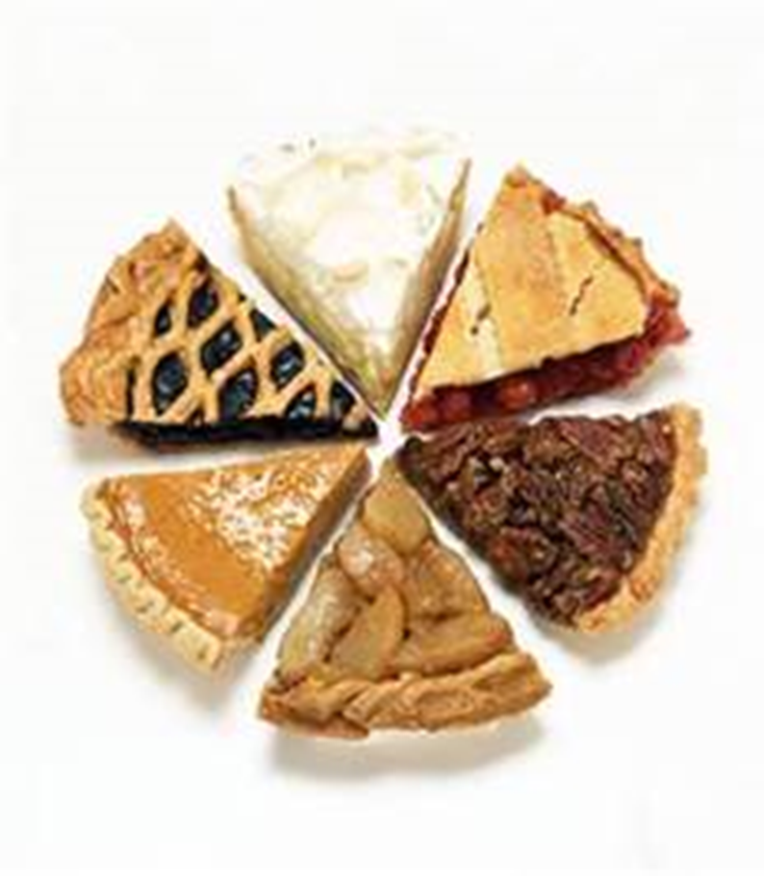
School leaders – why spend 30 minutes on this PD? - Then Delete This Slide!
#1 Factor to Student Achievement = Teacher Quality TCP is a slice of the teacher development (other slices include PD, coaching…) That’s why we want teachers to be invested in TCP and to understand how they’ll evaluated While advancing to Stage 4 and 5 is great, TCP is about growth at all levels. Stage 3 teachers are incredibly valuable team members. We celebrate growth within stages as well. We know we share the same goal as you:
TCP is a pathway for gap-closing teachers to stay in the classroom long-term.

Slide 2
Directions p1/ Then Delete This Slide!
The purpose of this deck:
Introduce your new teachers to TCP. They heard a quick overview at New Teacher Training, but this deck will help them to hear your perspective, how you incorporate TCP into your talent and instructional strategies, how you want them to leverage TCP, etc.
When to present this deck:
Any 30 min block of time prior to Lesson Observation Window 1 on Oct. 19
During a Friday PD, grade level team meeting, coaching meeting, etc. Any 30 minute block when your new teachers come together!
Who should present this deck:
Principal, dean, coach, advisory panelist, Distinguished teacher, etc.
How to prepare to present this deck:
Read it through once to understand the major points and where you should add your personal flavor and perspective (red text)
We included some talking points in the notes section of the slide as well. Please embellish with additional school-specific context.
This PD is not discussion focused – it’s meant to quickly deliver a lot of information in a visually engaging way
Add in that commentary! Please adjust as you see fit.
If you want ANY guidance, email katiecapella@achievementfirst.org for 1:1 support.

Slide 3
The Teacher Career Pathway: Overview of TCP in 15-16

Slide 4
Teachers are the key lever
Notes:
At Achievement First, it is one of our core beliefs that teacher quality is the #1 factor to student achievement
In order to meet our mission of equal educational opportunity for all of America's children, Achievement First believes every student must have a highly effective teacher.
The Teacher Career Pathway focuses on this singularly key lever in student achievement by empowering growth through thoughtful performance evaluations, and celebrating excellence with our Distinguished and Master teacher cohorts.

Slide 5
How was the Teacher Career Pathway created?
We Listened
Teachers & school leaders voted
Teachers talked
Notes:
Key points:
Teachers talked: (TALK)
2007:
Teachers told us that they wanted a way to be recognized if they chose stay in the classroom rather than become a school leader. Our best teachers also wanted development that would help them grow.
We listened: (EAR)
Leaders listened to this feedback and in 2009 presented Teacher Career Pathway as one of several options for career development.
Teachers voted: (THUMBS UP)
2009:
Doug, Dacia, Regional Sups and Network Support leaders presented options and principals and teachers gave it a thumbs up
Teacher career pathway was born

Slide 6
TCP Today
Defining a pathway to a long-term career in the classroom
Fair & continually improving
Best in Class, Nationally Recognized
Notes:
Today, the Teacher Career Pathway has evolved into a program that is best in class and has been nationally recognized. It defines a pathway to a long-term career in the classroom, and it’s both fair and continually improving.
Potential additional talking points on TCP as nationally recognized:
Among other places, TCP has been featured on PBS Newshour and in the Christian Science Monitor. We’ve been represented at numerous conferences, including the National Charter School Conference, the Aspen Institute, the TIF (Teacher Incentive Fund) Conference, Teach for America’s 20th Anniversary Summit, and more.
You can visit the TCP 101 Many Minds page for links to these resources.

Slide 7
How does TCP fit into teacher development?
If teacher development were a pie…
TCP would be only one slice.
And the AF Essentials of Instruction would be the crust.
The other slices would be weekly coaching, PD, lesson plan review, real time coaching…
Notes:
If teacher development were a pie, TCP would be only one slice. The other slices would be weekly coaching, PD, lesson plan review, real time coaching, etc., and the AF Essentials of Instruction would be the crust.
The Achievement First Essentials of Instruction defines a vision of excellence for classroom instruction – it’s the crust of the teacher development pie. These 5 key questions clearly define our vision of joyful rigor in the classroom and provide a framework for professional development, coaching and lesson observations (including TCP evaluations).

Slide 8
The Essentials – Crust of the teacher development pie that defines great teaching
RIGOR | Are students grappling with content aligned to the College Ready Bar?
FOCUS | Are students focused on the work of the lesson from start to finish?
INVESTMENT | Would students want to stay if they had the choice to leave?
THINKING | Are students doing the heavy lifting? Does instruction unleash the intellect of scholars?
FEEDBACK | Are students rapidly improving the quality of their work based on clear, actionable feedback?
Notes:
The 5 Essentials!
Question: Why are these Essentials important from both a development and evaluation standpoint?

Slide 9
What comprises the TCP “slice”?
Are your kids achieving?
Is your instruction consistently strong?
Are you building strong family and student relationships?
Are you a team player?
Student Achievement Measures
Lesson Observations
Peer and Leader Surveys
Family and Student Surveys
Notes:
How do we know you’re a strong teacher?
We ask 4 questions:
Is your instruction consistently strong?...
How do we measure each of these questions?
We use SAMs, Lesson Observations, Peer & Leader Surveys, etc.
When we answer these four questions we are able to understand where you are along the Teacher Career Pathway

Slide 10
Component #1 of the TCP slice - SAMs
We calculate the growth of each of your scholars.
We compare that growth to the vision of excellence for each scholar.
We roll up all this data into a SAMs score.
Notes:
SAMs are a measure of student growth.
Additional talking points if needed - they are…
Growth-based – we look at how much all students have grown relative to their starting point rather than focusing on how many students reach proficiency
Comprehensive – great teachers demonstrate growth for ALL of their students, not just some
Noncompetitive – all teachers have the ability to receive a high SMAs score
Differentiated – SAMs account for student difference – i.e., it is more difficult to show growth for students who start above grade level compared with those who start below grade level, and our model accounts for this
Principals and regional sups carefully review SAMs scores before they are finalized to ensure fairness and consistency across schools

Slide 11
Component #2 of the TCP slice – Lesson Observations
Lesson observations
Live and unannounced
Snapshot of a typical day in your class
Comprehensive Observations
Based on informal observations over the course of the school year
Notes:
Another slice of the TCP pie are lesson observations
Scholars deserve high-quality, joyfully rigorous lessons every day.
Lesson Observations measure quality of instruction and provide a snapshot of​ a teacher’s performance while the Comprehensive Evaluation assesses a teacher over the course of the year.
Lesson observations are based on the AF Essentials Rubric. ​​ ​​

Slide 12
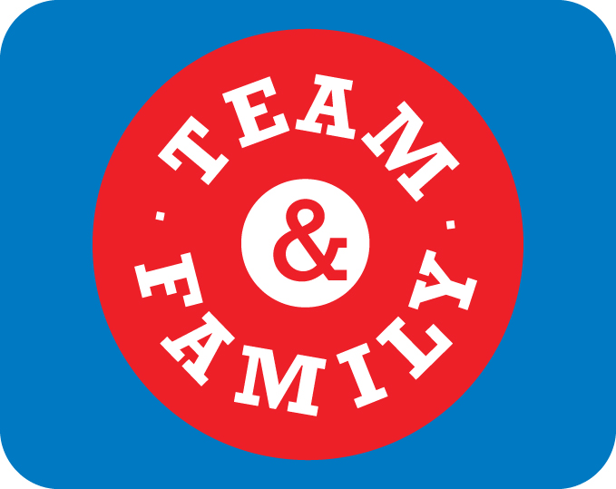
Components #3 & #4 of the TCP slice - Surveys
Family & Student Surveys:
Are you building strong family and student relationships?
Peer & Leader Surveys:
Are you a team player?
Notes:
Family and Student Survey: Family and student surveys measure the relationship you build with the children and families that we serve. Student surveys are only sent in grade 3 and up (for obvious reasons ☺)
Peer and Leader Survey: Because we know that teaching is a team sport and that AF’s most effective teachers must also be strong members of their grade-level, content, and school teams, the Teacher Career Pathway includes a peer survey and school leader survey to gather feedback on each teacher’s core values and contributions to team achievement.

Slide 13
How is my overall score calculated?
Is your instruction consistently strong?
Are you a team player?
Are you building strong family and student relationships?
Are your kids achieving?
Lesson Observations
Peer and Leader Surveys
SAMs (Student Achievement Data)
Family and Student Surveys
TCP overall score
Notes:
These 4 components are weighted differently depending on the type of teacher you are. Each component is converted into points and then added up to an overall score, which is used to determine your place along the Teacher Career Pathway.

Slide 14
How do I progress along the pathway?
Stage 5
Stage 4
Stage 3
bulk of teachers
Stage 2
Stage 1
Master Teacher – role model, gap-closing teachers
Distinguished Teacher - proven track records of quality instruction
Teacher - Consistently demonstrating solid results; on average students grow more than one year’s worth
New Teacher – first 2-3 years of teaching, learning and developing
TIR - just starting out in their career
Notes:
The pathway has 5 stages – while we celebrate our distinguished and master teachers, as you can see here stage 3 teachers make up the backbone of our network. Stage 3 should be seen as solid performers consistently contributing to scholar achievement. These teachers consistently deliver solid results and continue to hone their craft.
We have intentionally set an extremely high bar for stage advancement. Some schools may not have any Stage 4 or 5 teachers advance in a given year.
We see stage advancement as an enormous milestone in a long-term career path; we want you to aspire to become a Distinguished or Master teacher but it takes time. The key is that you’re growing from year to year.

Slide 15
What mindsets do teachers need to grow?
Growth minded teachers ask themselves:
Where am I showing growth?
How am I performing relative to a high bar of excellence?
What are my areas of strength and areas of development?
Notes:
Turn & Talk to your neighbor –
What does it mean to have a fixed mindset?
What would it mean to have a growth mindset?
Your TCP data tells you much more than your stage:
Key messages:
This is a career path. It’s not something to be achieved within a couple of years.
Stage 3 teachers are effective teachers who are consistently growing in their craft; they make incredibly valuable contributions to our schools and are making a difference for the scholars they reach.
Effective teachers use their TCP data to track areas of growth and their progress from year to year
TCP isn’t just about “making it” to Stage 4

Slide 16
How does TCP connect to Arc of the Year?
Weeks 19-24
Feedback
Weeks 11-18
Thinking
Weeks 7-11
Rigor
Weeks 1-6
Focus &
Investment
AOTY builds towards our larger vision of teaching – the AF Essentials
Notes:
TCP observations in particular are closely tied to the AOTY priorities.
The Arc of the Year builds towards our larger vision of teaching as outlined in the AF Essentials.

Slide 17
What You Can Do to Learn More
At our school…
Talk with your coach
Ask NAME, NAME or NAME (Stage 4 Teachers / Advisory Panel Reps)
On your own…
Look on Many Minds
Log in to Platinum - all your TCP data will be housed here
Access via Many Minds
Email teachercareerpathway@achievementfirst.org

Slide 18
Final Thoughts
Insert closing image/metaphor; recommendation is to add picture of your staff
Notes:
Key messages:
IN ADVANCE: Choose your own inspirational ending and metaphor. E.g., team working together to contribute to the success of our students
“Every year we get better--I’m excited to see our school team develop through the Teacher Career Pathway this year to create an even more rigorous and joyful learning environment for our scholars than ever before.”
YOUR ADDITIONAL FINAL THOUGHTS

